Slide 1
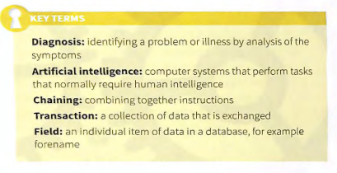
Expert System

Slide 2
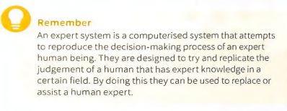
What’s An Expert System?
Expert systems use a knowledge base and a set of rules
to provide a diagnosis or a recommended course of
action .

Slide 3
Expert Systems
Expert systems gather data by asking the user questions about the problem. An initial set of questions can lead to further questions depending on the user's responses. The expert system reasons what questions it needs to ask, based on the knowledge it is given. It will use the responses from the user to rule out various possibilities that will allow it to eventually reach a decision or diagnosis.
The concept of an expert system was first developed in the 1970s by Edward Feigenbaum, who founded the knowledge- based system laboratory at Stanford
University . Expert systems are thought to be among the first truly successful forms of artificial intelligence.

Slide 4
Three Main Components:-
the knowledge base
the inference engine
the user interface.

Slide 5
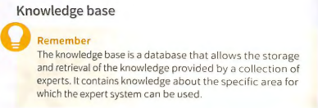
Expert System....
The developers of the expert system wi ll inter v iew a collect ion of experts to build the databas e of knowledge. They will look to gain two types of knowledge from the experts. The first is factual knowledge. This is knowledge that is widely shared. The second type is heuristic knowledge. This is knowledge that is more personal and is acquired through a range of experience s and reasoning. Once the knowledge base is built, it can be used by the expert system to inform the questions it needs to ask and nassist in providing the results.

Slide 6
Expert System....
Part of the knowledge base is the rules base. The rules base is a set of rules that will be used to produce an output or decision by the expert system. These rules are used by the inference engine as a base for reasoning, to obtain a solution to a problem or a decision. Each rule will contain two parts, the IF and the THEN. A rule can also have multiple IF parts that will be join ed tog eth er by Boolean operators including AND and OR. Most expert systems will have a knowledge based editor built into them. This allows the knowledge base to be checked for errors and edit ed and updated when needed.

Slide 7
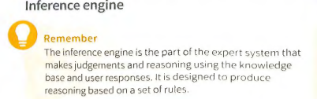
Inference Engine
It will ask the user questions, and based on their answer, it will follow a line of logic. This may thten lead further questions and eventually a final result. The inference engine is mostly a problem-solvrng tool. It organises and controls steps to solve the problem.Todo this it often uses a chaining method. It chains together
what is known as IF-THEN rules to form a line of reasoning. The IF part of the rule is a condition, for example IF I am hungry. The THEN part of the rule is an action, for example IF I am hungry THEN I will need to eat.

Slide 8
Expert System....
There are two main methods that can be used to obtain a result. The appropriate one will depend on whether the expert system is designed to produce a final result i.e a diagnosis or course of action, or if it begins with a known conclusion i.e. a goal. If the process starts with a set of cond itions and chaining moves towards a final conclusion, this is called forward chaining.
In a forward chaining system, the expert system will take the data input and match it to the knowledge and rules it contains. It will keep doing this until it can reach an end goal or outcome. A forward chaining system is data driven.Data is gathered about the probl em and then the system infers what it can from the data to reach a conclusion.
If the process starts with a known conclusion, but the pathto it is unknown, the chaining will work in reverse and this is called backward chaining. The system in th is case has a goal or solution and the inference engine attempts to find
the evidence to prove it.

Slide 9
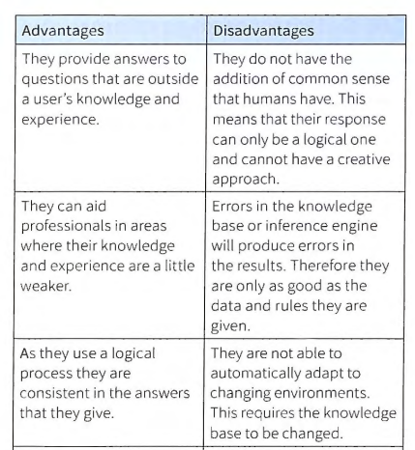
Expert System

Slide 10
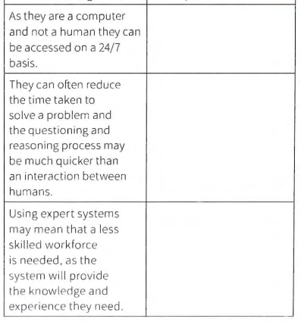
Expert system

Slide 11
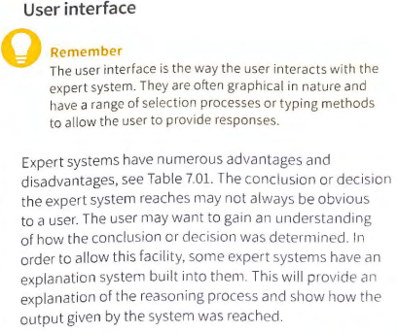
expert system

Slide 12
How are expert systems used
Expert systems are used by many individuals and organizations for variety of diffrent purposes. These include:
medical diagnosis
car mechanical diagnosis
playingchess
providing financial advice
troubleshooting computer and printer issues
identifying items, for example plants and birds
Using a telephone helpdesk.

Slide 13
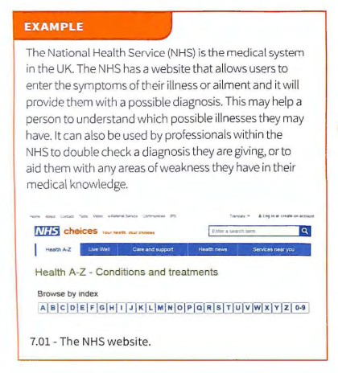
Examples

Slide 14
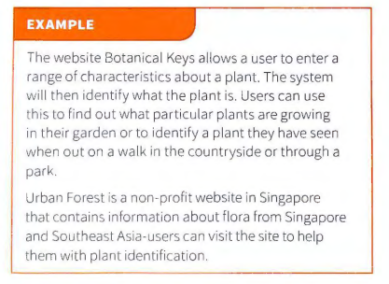
Example of Expert System

Slide 15
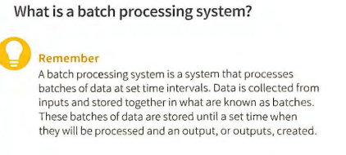
Data processing systems
There are many types of systems that process data, and a variety of ways the processing can be carr ied out. A system that processes data will have a metho d to input the data, a method to process the data and a method to output the data. We are going to look at three ways in which data can be processed These are batch, on line and real-time process ing systems.

Slide 16
Data processing system....
The amount of data processed by batch processing systems is nor mally quite large. By storing the data together in batches, it means tha t the processing can be carried out at a time when the system is in less demand.
This results in less disruption to a system during the times of the day when it could be in heavy demand. No user interaction is required to process the data. The system is
automatically triggered at a set time. There are issues that can occur with a batch processing system. There is a tim e delay for the data processing,so the output that will be provid ed is not always readily availab le. Also, if there is an error with an input, this will not be recognised until a later date when the data is processed.

Slide 17
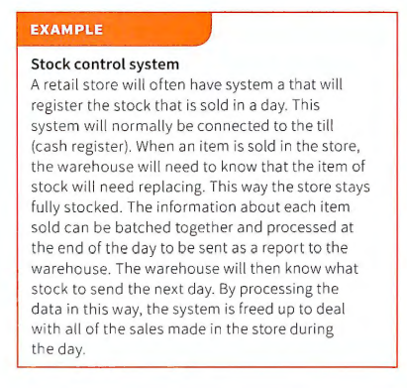
Example of batch processing

Slide 18
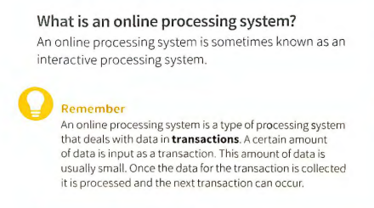
Online Processing

Slide 19
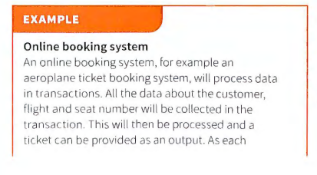
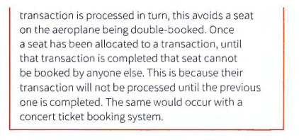
Example of online processing

Slide 20
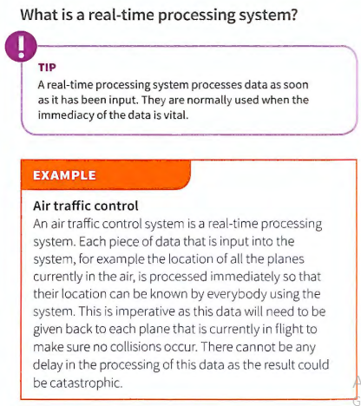

Slide 21
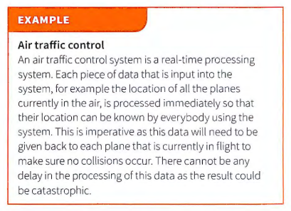
Example of Real-time Processing

Slide 22
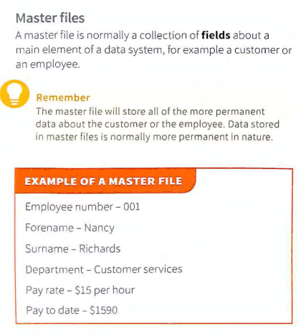
Master file

Slide 23
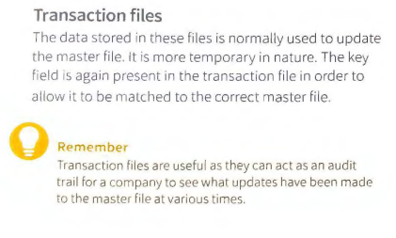
Transaction file

Slide 24
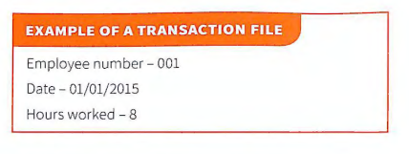
Example of transaction files

Slide 25
